Slide 1

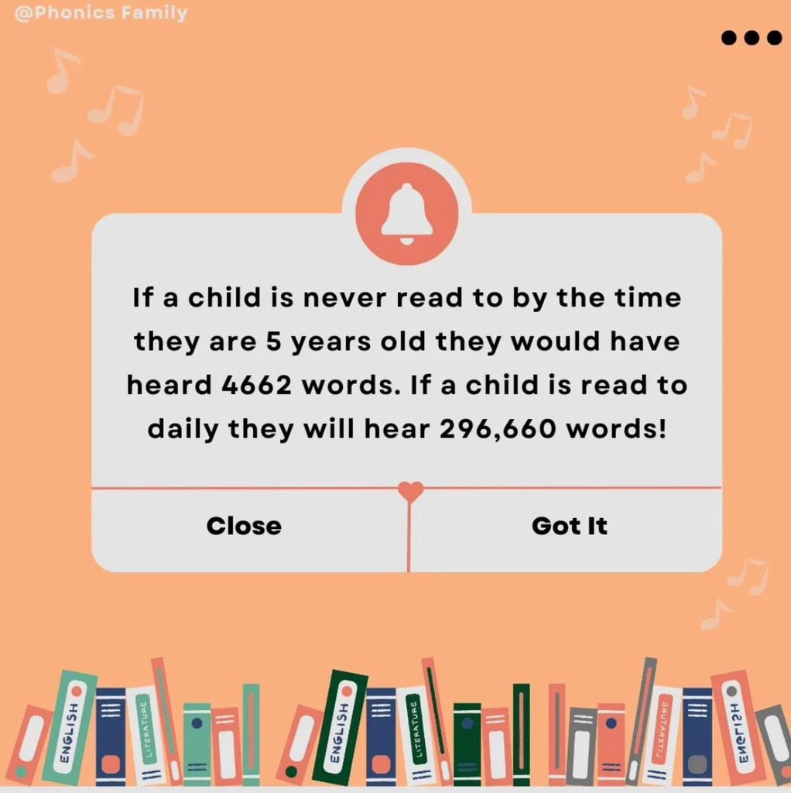
Supporting your child with reading in Reception
Mrs J Barton

Slide 2

Phonics: it’s like another language!
What is a phoneme?
What is a Grapheme?
What does it mean to decode?
What is a Digraph?
What is Schwa?
Great resources to help:
BBC alphablocks: fantastic for re-enforcing learning and blending sounds to read words.
@Phonics Family on Instagram: great home learning ideas to make learning to read fun!
Little Wandle how to videos: https://www.youtube.com/watch?v=-ZtjFIvA_fs

Slide 3

Phonics in school
We follow the Little Wandle Letters and Sounds program.
Phonics sessions are daily and will build up to be 25 minutes.
Interventions will take place in the afternoons for children who are finding phonics a challenge.
Guided reading will occur 3x a week using big

Slide 4
Reading in school
We will have reading sessions three times a week each day we will focus on a different skill for reading:
Read 1. decoding: focus on recognising the phonemes and blending them to read words.
Read 2. prosody: reading with meaning, stress and intonation.
Read 3. comprehension: understanding the text.
This book will then come home and be your child's ‘reading practice’ book.

Slide 5


We teach Phase 2 in this order
Notes:
Slide purpose:
To provide an overview of the Phase 2 sounds
Suggested script:
We usually teach four new sounds a week and have a review lesson on a Friday.
You will get a list of the sounds that we are learning to have at home. This will help you with letter formation (handwriting) and pronunciation.
Give the Phase 2 grapheme information sheet for Autumn 1 to parents.

Slide 6

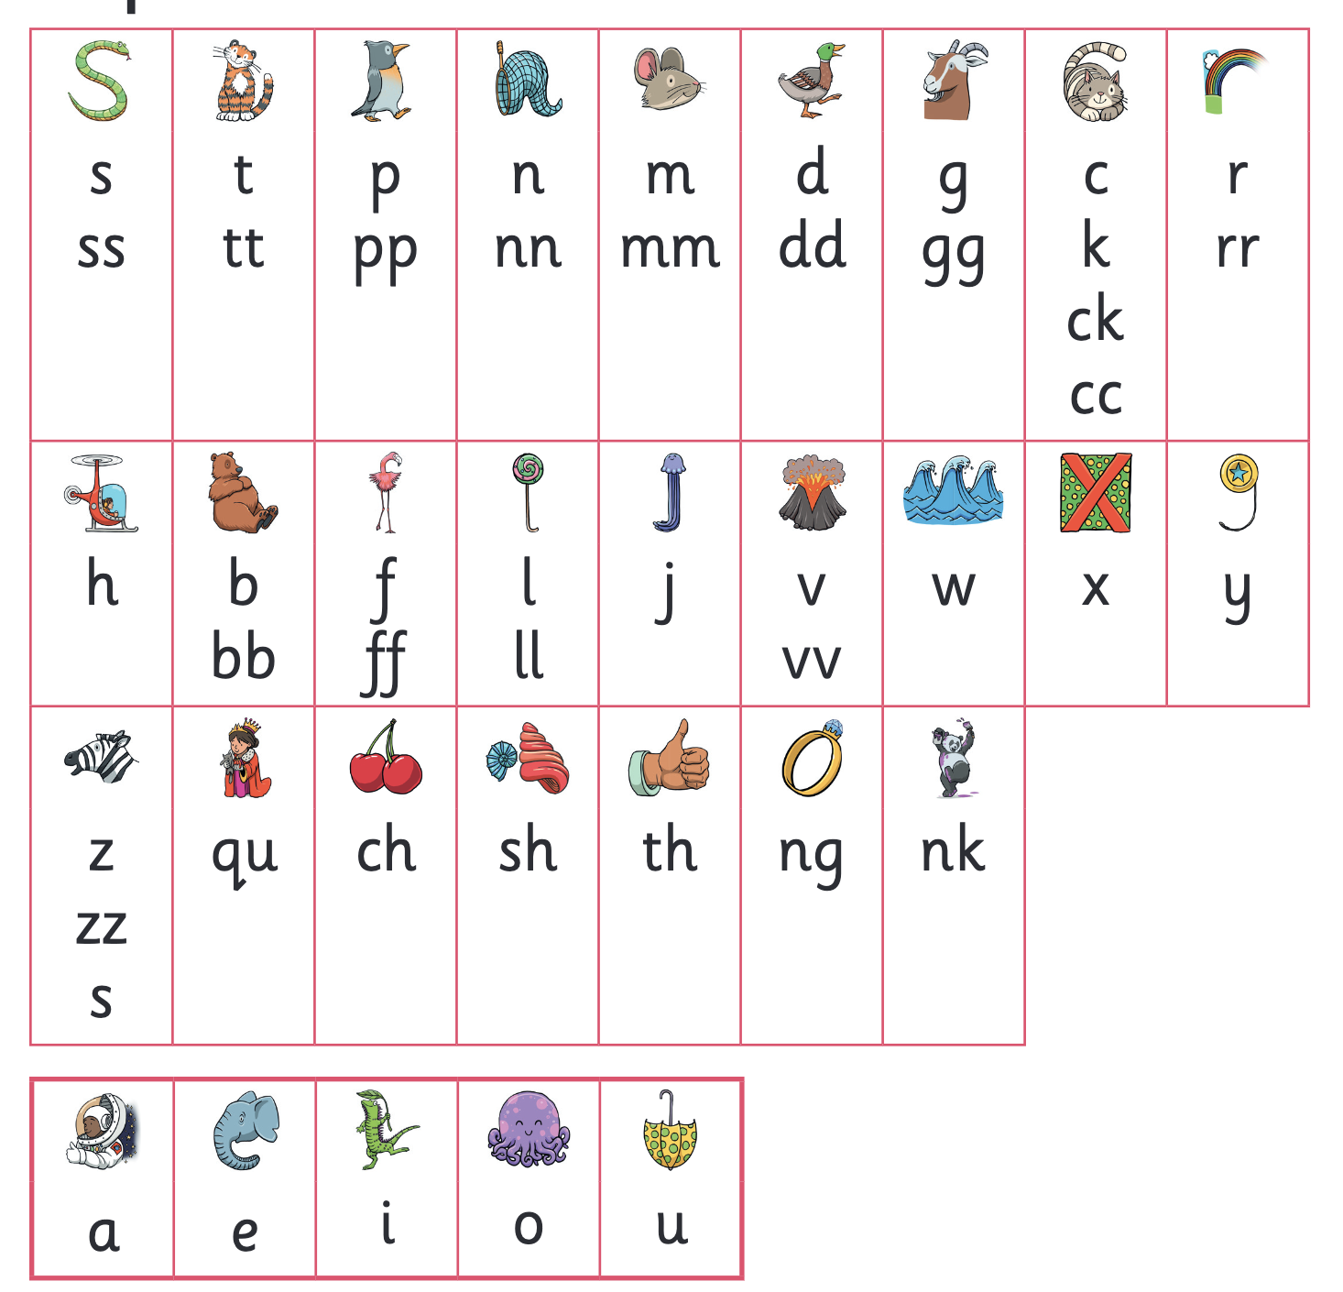
Let’s say the Phase 2 sounds
Notes:
Slide purpose:
To practise the Phase 2 sounds
Notes
Give out the parent handout and the Phase 2 and 3 grapheme mat.
Play the videos/teach the parents to say the Phase 2 sounds: https://www.littlewandlelettersandsounds.org.uk/resources/for-parents/
Show parents where to access these videos in the ‘For parents’ area of the Little Wandle website.

Slide 7

Blending to read words
Notes:
Slide purpose:
To provide an overview of blending
Suggested script:
Some children learn to blend really quickly, and others take a little longer.
If your child is finding it difficult, ask your child’s teacher for ways to help at home – playing blending games at home is so helpful!
Show parents the ‘How we teach blending’ video from ‘For parents’ area of the website: https://www.littlewandlelettersandsounds.org.uk/resources/for-parents/

Slide 8
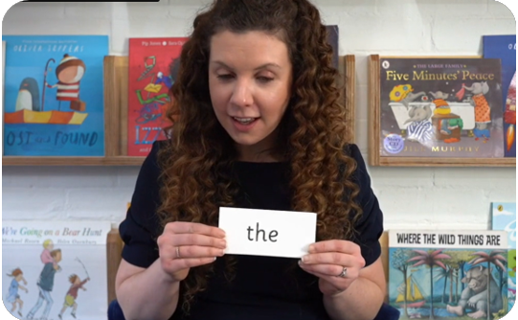
Tricky words
These words have unusual spellings e.g. he, the, was.
They are taught in a systematic way.
Children are now learning to read the Phase 2 tricky words: is, I, the, put, pull, full, as, and, has, his, her, go, no, to, into, she, push, he, of, we, me, be.
Notes:
Slide purpose:
To introduce tricky words
Notes:
Read the slide.
You may wish to give parents a copy of the document ‘Phase 2 tricky words: Reception Autumn term – Information for parents and carers'.

Slide 9
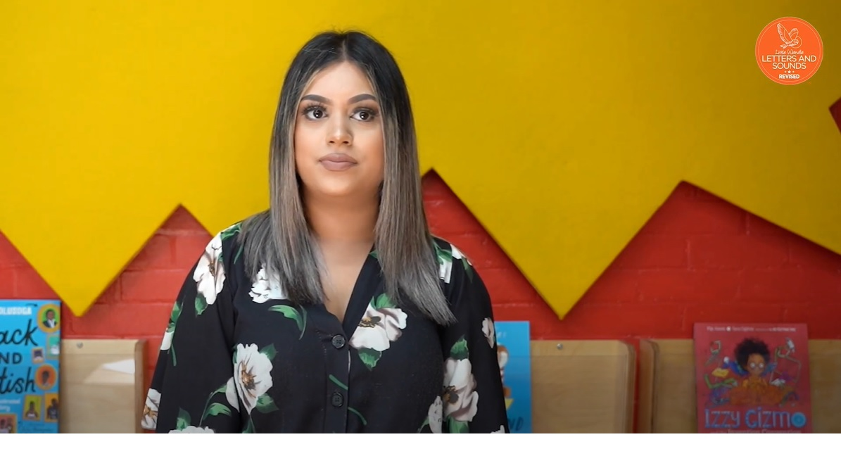
Reading tricky words
Notes:
Slide purpose:
To provide an overview of tricky words
Notes
Watch the ‘How we teach tricky words’ video on the website: https://www.littlewandlelettersandsounds.org.uk/resources/for-parents/

Slide 10
Reading at home
You child will come home with two types of book:
A reading practice book. This will be at the correct phonic stage for your child. They should be able to read this fluently and with only a little encouragement and support from you.
A sharing book. Your child will not be able to read this on their own. This book is for you both to read and enjoy together. They may be able to spot some sounds they have learned, or some of ‘trick words’ they are learning. They may be able to decode some simple words too.

Slide 11
Reading practice book
This book has been carefully matched to your child’s current reading level. If your child is reading it with little help, please don’t worry that it’s too easy – your child needs to develop fluency and confidence in reading.
Listen to them read the book. Remember to give them lots of praise – celebrate their success! If they can’t read a word, read it to them. After they have finished, talk about the book together.
Your child should re-read this same book several times in the week. This develops their confidence and comprehension of the story.

Slide 12
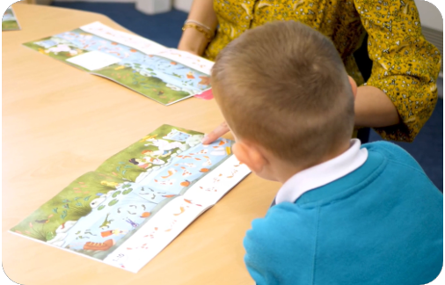
Reading a wordless books
Wordless books are invaluable as they teach reading behaviours and early reading skills to children who are not blending – yet!
Talk about the pictures.
Point to the images in the circles and find them on the page.
Encourage your child to make links from the book to their experiences.
Notes:
Slide purpose:
To give guidance on reading wordless books at home
Notes:
Read the slide.

Slide 13
Sharing book
In order to encourage your child to become a lifelong reader, it is important that they learn to read for pleasure. The sharing book is a book they have chosen for you to enjoy together.
Please remember that you shouldn’t expect your child to read this alone. Read it to or with them. Discuss the pictures, enjoy the story, predict what might happen next, use different voices for the characters, explore the facts in a non-fiction book. The main thing is that you have fun!

Slide 14

Books going home
Notes:
Slide purpose:
To introduce the process and format for reading at home
Suggested script:
As well as the ‘learning to read’ book that your child will bring home they will also bring home a book for sharing with you.
This shared book is SO important. This is how we are going to give them the WILL to read.
Please read with your child as often as you can – at least once a day if possible.

Slide 15
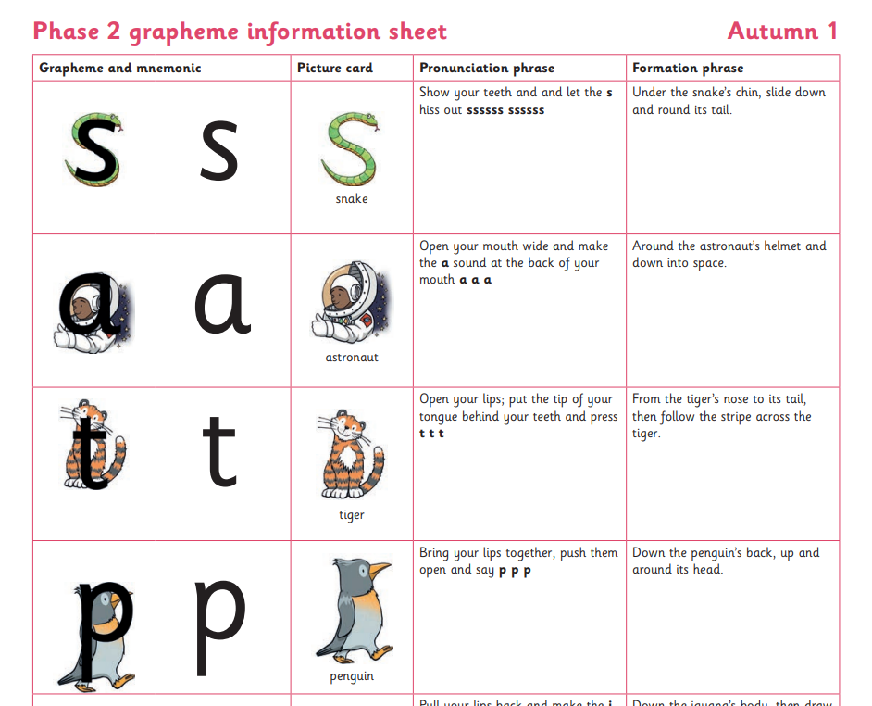

Spelling
Your child will be taught how to spell simple words, using the graphemes they have been taught.
They will practise the correct formation of letters. They will also have handwriting lessons.
Notes:
Slide purpose:
To introduce spelling
Notes:
Read the slide.
Hand out the Phase 2 grapheme information sheet for Autumn 1, which includes the formation phrases.

Slide 16

How do we teach spelling?
Say the word.
Segment the sounds.
Count the sounds.
Write them down.
Notes:
Slide purpose:
To provide an overview of spelling
Notes:
Model the process above on a flipchart for the parents to see.
Show the process with a Phase 2 word, e.g. pin, dig, hug.

