Slide 1

Longwick Maths Mastery Parent Workshop
Thursday 24th November 2022

Slide 2

Our aim at Longwick is for all children to enjoy maths and have a secure and deep understanding of fundamental mathematical concepts and procedures when they leave us to go to secondary school.

Slide 3
What does Mastery of Mathematics mean at Longwick?
It is achievable for all

Slide 4
What does Mastery of Mathematics mean at Longwick?
Deep and sustainable learning

Slide 5
What does Mastery of Mathematics mean at Longwick?
The ability to build on something that has already been sufficiently mastered

Slide 6
What does Mastery of Mathematics mean at Longwick?
Conceptual and procedural fluency

Slide 7
What does Mastery of Mathematics mean at Longwick?
Problem solving is central

Slide 8
What does Mastery of Mathematics mean at Longwick?
Challenge through greater depth and ‘Deepen’

Slide 9
Mastery of Mathematics at Longwick
Concrete - providing children with objects and resources to manipulate in order to demonstrate their mathematical thinking.
Pictorial - providing opportunities for children to represent their mathematical thinking through diagrams, images, drawings or models.
Abstract – providing opportunities for children to become more familiar with formal mathematical representations including signs, symbols and digits.

Slide 10
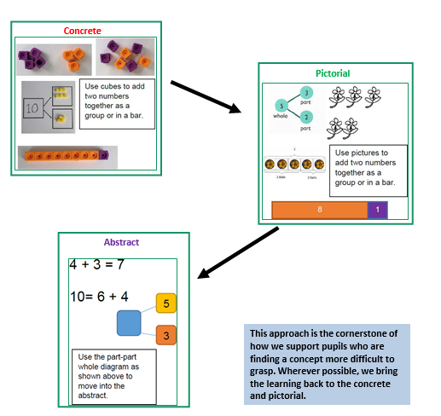
CPA

Slide 11
Questioning and prompts are powerful tools to boost your child’s mathematical thinking.

Slide 12
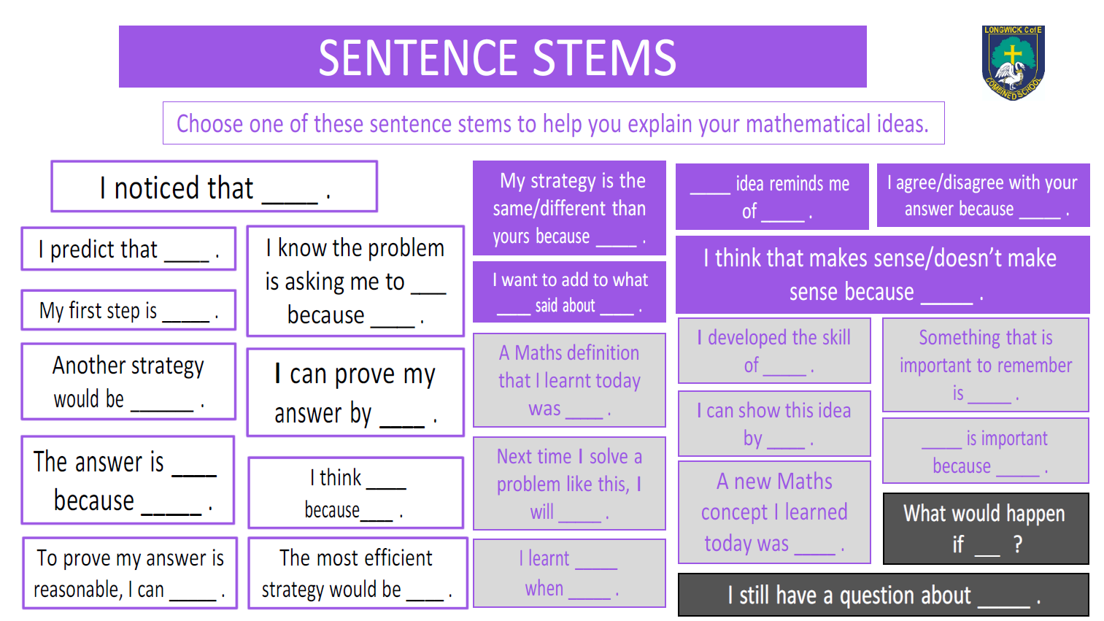

Slide 13

How can you support your child at home?
White Rose Maths
Parent resources | Maths workbooks | White Rose Maths

Slide 14
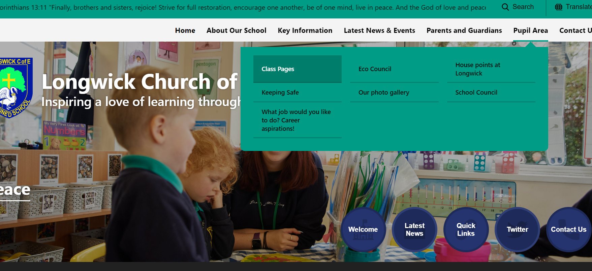
The Class pages

Slide 15
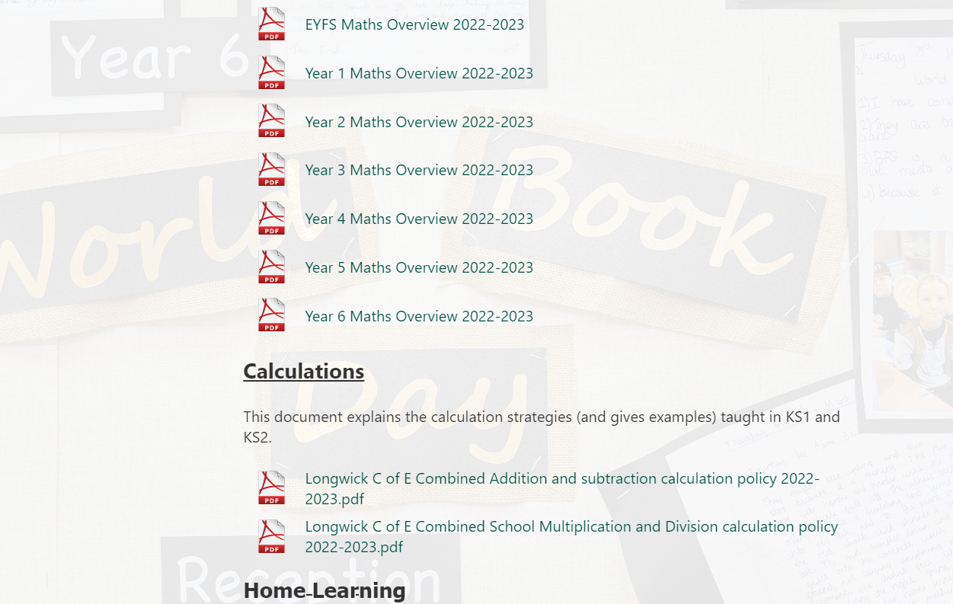
Maths | Longwick Church of England Combined School
The Class Overviews and Calculation Policies

Slide 16
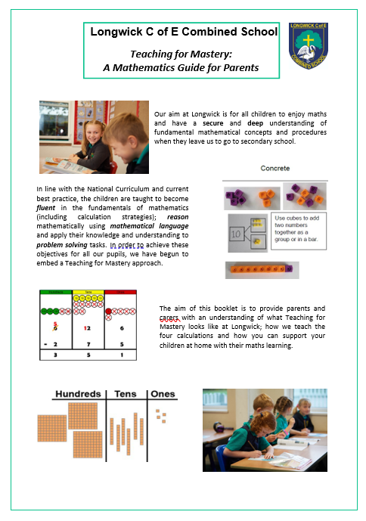
Mastery of Mathematics at Longwick
Parent Information Guides

Slide 17
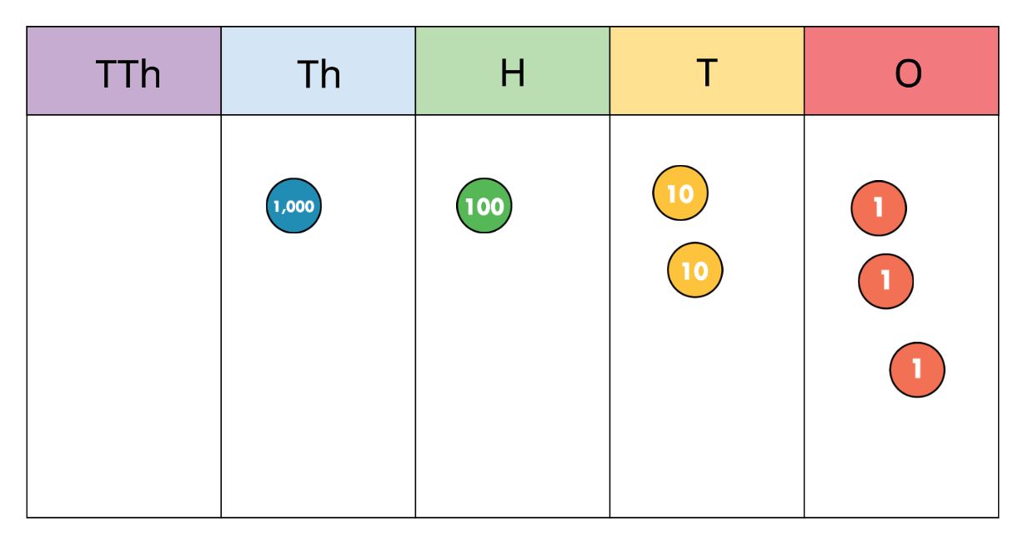
An example of a change in the mathematical language which is now used

Slide 18

Do you Have Any Questions?

